Slide 1

2026 AIO HIGH ACHIEVERS CAMP · SESSION 2
BINARY SEARCH + TWO POINTERS
Notes:
第 2 次课的主题是单调性（monotonicity）：它从哪里来，Binary Search 和 Two Pointers 怎样利用它。今天有三种来源：题目直接给的（Laser Cutter）、用前缀最小值造出来的（Space Mission）、用总和造出来的（Lollipops II）。

Slide 2
LESSON 2 · 2 HOURS
TODAY'S PLAN
Time | Content | Technique
0:00–0:10 | Recap, the solution space, the template | Binary Search
0:10–0:40 | 2021 P6 Laser Cutter | Binary search on the answer
0:40–1:00 | 2021 P5 Space Mission | Prefix minimum + Binary Search
1:00–1:30 | 2019 P6 Lollipops II | Binary Search + Two Pointers
1:30–1:55 | Live coding: Space Mission | Full program + samples
1:55–2:00 | Recap and homework | —
Notes:
先用 5 分钟讲上次的作业（Tennis Robot II）：谁的轮数除法公式写对了？
参考：t = (s − 1) / (−d[i]) + 1，其中 s = X[i] + mn[i]；s < 1 时 t = 0；d[i] ≥ 0 时跳过。

Slide 3
THE FOUR CORE TECHNIQUES
TODAY: THE MONOTONE PAIR
Prefix Sum
Binary Search
Session 1: running totals, net change per round
Needs: a check that flips from "no" to "yes" exactly once
Two Pointers
Greedy
Needs: both ends of a window only ever move forward
Session 3: the water-level idea
Both need the same thing: something monotone.
Notes:
今天每道题都问同一个问题：单调性从哪里来？是题目给的，还是我们自己造出来的？
接下来两页先不看具体题目，而是从"解空间的形状"讲起：什么样的形状可以二分，二分的循环到底在做什么。

Slide 4
BINARY SEARCH · START FROM THE SOLUTION SPACE
WHAT DOES THE SOLUTION SPACE LOOK LIKE?
Line up every candidate answer x in order and ask check(x): yes ✓ or no ✗. The row of answers has a shape.
check(x) | 1 | 2 | 3 | 4 | 5 | 6 | 7 | 8 | 9 | 10
Monotone | ✗ | ✗ | ✗ | ✗ | ✓ | ✓ | ✓ | ✓ | ✓ | ✓ | one boundary → binary search
Monotone | ✓ | ✓ | ✓ | ✓ | ✓ | ✓ | ✗ | ✗ | ✗ | ✗ | one boundary → binary search
Not monotone | ✗ | ✓ | ✗ | ✗ | ✓ | ✓ | ✗ | ✓ | ✗ | ✗ | no boundary → check them all
Binary search does not look for the answer. It looks for the boundary between ✗ and ✓.
Notes:
从解空间（solution space，也叫 search space）讲起：把所有可能的答案 x 从小到大排成一行，对每个 x 问一次 check(x)：行（✓）还是不行（✗）。然后看这一行 ✓ / ✗ 的"形状"。
单调（monotone）= 只有一条分界线：✗✗✗✓✓✓ 或 ✓✓✓✗✗✗。这时随便查中间的一个 mid，就知道分界线在它左边还是右边，可以扔掉一半 → Binary Search。
不单调：✓ 和 ✗ 交错。查到一个 ✗，不知道 ✓ 在左边还是右边 → 不能二分。要么全部检查，要么换一个单调的量（今天的 Lollipops II 就是这样）。
提问：第 1 次课哪道题也有这种形状？参考答案：Tennis Robot II，"箱子 i 能撑过 r 轮吗？"随 r 增大是 ✓✓✓✗✗。那里我们用除法直接算出了分界线。
一句话总结：二分找的不是答案本身，而是 ✗ 和 ✓ 的分界线。

Slide 5
BINARY SEARCH · HOW THE LOOP USES THE SHAPE
EACH CHECK THROWS AWAY HALF THE ROW
Step | 1 | 2 | 3 | 4 | 5 | 6 | 7 | 8 | 9 | 10
check(x) | ✗ | ✗ | ✗ | ✗ | ✗ | ✗ | ✓ | ✓ | ✓ | ✓ | hidden from us
1: l = 1, r = 10 | ? | ? | ? | ? | ✗ | ? | ? | ? | ? | ? | mid = 5: ✗ → l = 6
2: l = 6, r = 10 |  |  |  |  |  | ? | ? | ✓ | ? | ? | mid = 8: ✓ → r = 7
3: l = 6, r = 7 |  |  |  |  |  | ✗ | ? |  |  |  | mid = 6: ✗ → l = 7
4: l = 7, r = 7 |  |  |  |  |  |  | ✓ |  |  |  | mid = 7: ✓ → r = 6, stop
End |  |  |  |  |  | r | l |  |  |  | r = last ✗, l = first ✓
The loop always ends with l = r + 1. 10 candidates need 4 checks; 10⁹ candidates need about 30.
Notes:
用左边那个模板（check 为真 → r = mid − 1，否则 l = mid + 1）一步一步走这张表。第一行是"真实的"✓ / ✗，但程序看不到，只能一次查一个 mid。
答案就是表格：mid = 5 是 ✗ → 分界线在右边，l = 6；mid = 8 是 ✓ → 分界线在左边，r = 7；mid = 6 是 ✗ → l = 7；mid = 7 是 ✓ → r = 6，l > r，循环结束。
结束时 r = 6 是最后一个 ✗，l = 7 是第一个 ✓，而且 l = r + 1 总是成立。所以：要第一个 ✓（形状 ✗✗✓✓）输出 l；要最后一个 ✓（形状 ✓✓✗✗）用另一个写法，输出 r。
每次扔掉一半：N 个候选只要约 log₂N 次 check。10 个 → 4 次，10^9 个 → 约 30 次。
提问：如果整行都是 ✗，循环结束时 l 是多少？答案：l = N + 1（越界），表示没有可行值，要特判。

Slide 6
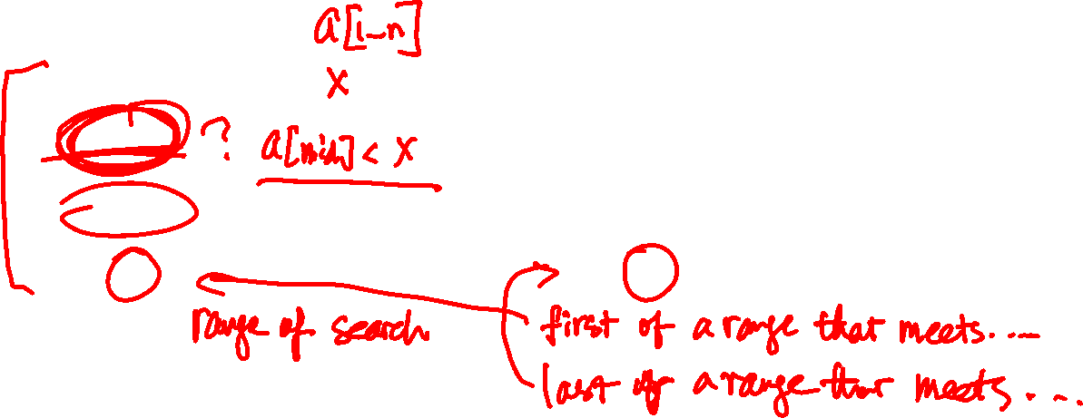
ONE TEMPLATE FOR THE WHOLE COURSE
THE WHILE (L <= R) TEMPLATE
First value that passes → l
Last value that passes → r
Shape ✗ ✗ ✗ ✓ ✓ ✓
Shape ✓ ✓ ✓ ✗ ✗ ✗
while (l <= r){
int mid = (l + r) / 2;
if (check(mid))
r = mid - 1;
else
l = mid + 1;
}
// answer: l
while (l <= r){
int mid = (l + r) / 2;
if (check(mid))
l = mid + 1;
else
r = mid - 1;
}
// answer: r
Notes:
这和课程里 timber、expense 题用的是同一个模板。
提问："能放下的最大正方形"用哪个写法？答案：找最后一个可行值 → 输出 r。
"总和达到 S 的最小半径"用哪个写法？答案：找第一个可行值 → 输出 l。
两种形状对应两种写法：✗✗✗✓✓✓ 找第一个 ✓，输出 l；✓✓✓✗✗✗ 找最后一个 ✓，输出 r。和上一页的表格对照：循环结束时 r 停在最后一个 ✗，l 停在第一个 ✓。

Slide 7

2021 AIO PROBLEM 6
LASER CUTTER
The biggest square that fits between two staircase cuts.
Binary Search · main
Two Pointers · optional
Prefix Sum
Greedy
Notes:
约 30 分钟。这里的单调性是题目直接给的：两条切割线都是阶梯（staircase）。

Slide 8
LASER CUTTER
THE PROBLEM
An N×N board. Two cuts run from the top-left corner to the bottom-right corner, using only R (right) and D (down).
Cut A is the lower boundary, cut B the upper one. Find the side of the largest axis-aligned square that fits between them.
N ≤ 200 000
Notes:
在右侧画样例 2：A = DDDDDDRRRRRR（先下后右），B = RDRRDDDRRRDD。答案是 3。

Slide 9
LASER CUTTER · QUESTION 1
BRUTE FORCE, AND WHY IT FAILS
Mark every cell inside the shape, then try every top-left corner and every size: O(N⁴), or O(N³) with a 2D prefix sum.
But N = 200 000 means 4×10¹⁰ cells. We cannot even store the grid.
We must use the special shape of the cuts.
Notes:
Brute force 仍然值得写：它能拿 N ≤ 10 和 N ≤ 1000 的 subtask 分，之后还能当对拍用的 checker。

Slide 10
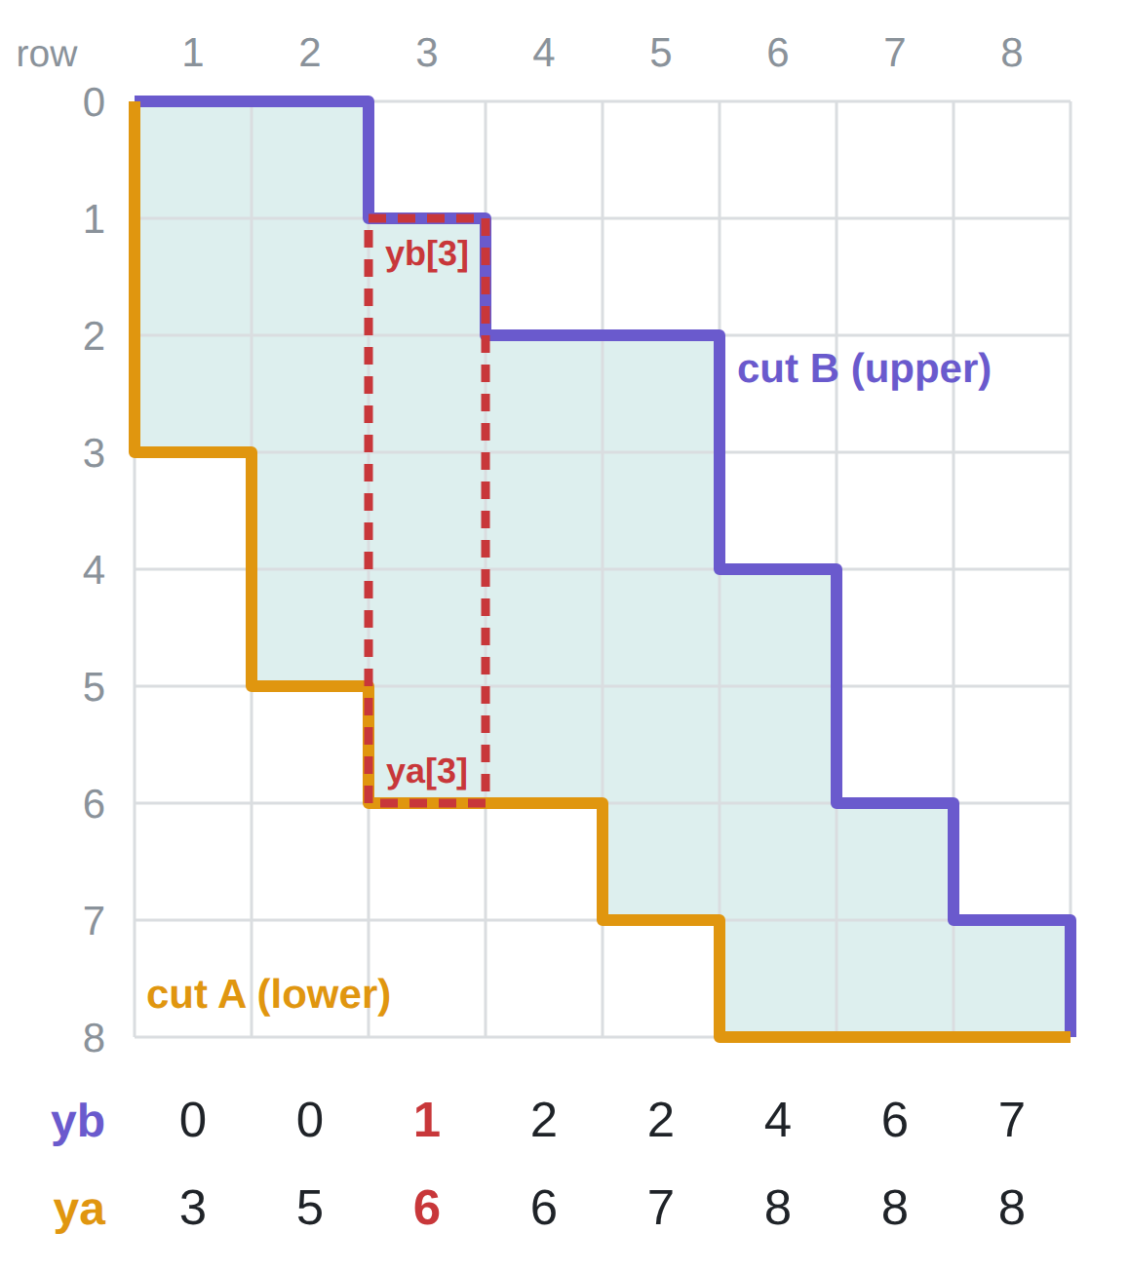
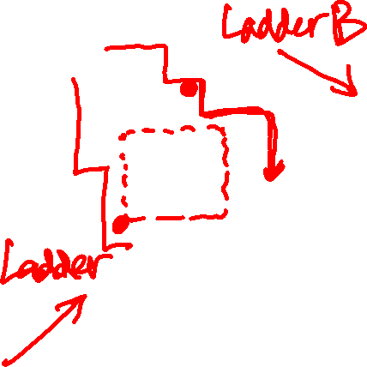
LASER CUTTER · KEY OBSERVATION 1
DESCRIBE THE SHAPE COLUMN BY COLUMN
Walk each cut. Each time it steps right through column x, record the current row:
yb[x] = top of column x
ya[x] = bottom of column x
Column x holds rows yb[x] … ya[x] − 1.
Both arrays never decrease (the cuts only go right and down): a staircase.
A new example (N = 8), not a sample
Notes:
单调性就是从这里来的，而且是题目直接给的。画一列，标出 yb 和 ya。
参考（样例 2）：ya = 6 6 6 6 6 6，yb = 0 1 1 4 4 4，两者都单调不减。
右图是新编的例子（N = 8，不是样例，免得提前给出第 12 页的答案）：紫线是上边界 B，橙线是下边界 A，青色格子是两条切割线之间的形状。每次切割线向右走过第 x 列时，记下当时的行号：yb = 0 0 1 2 2 4 6 7，ya = 3 5 6 6 7 8 8 8。红色虚线框是第 3 列：它占第 yb[3] = 1 行到第 ya[3] − 1 = 5 行。两行数字都从左到右单调不减，这就是"阶梯"（staircase）。

Slide 11
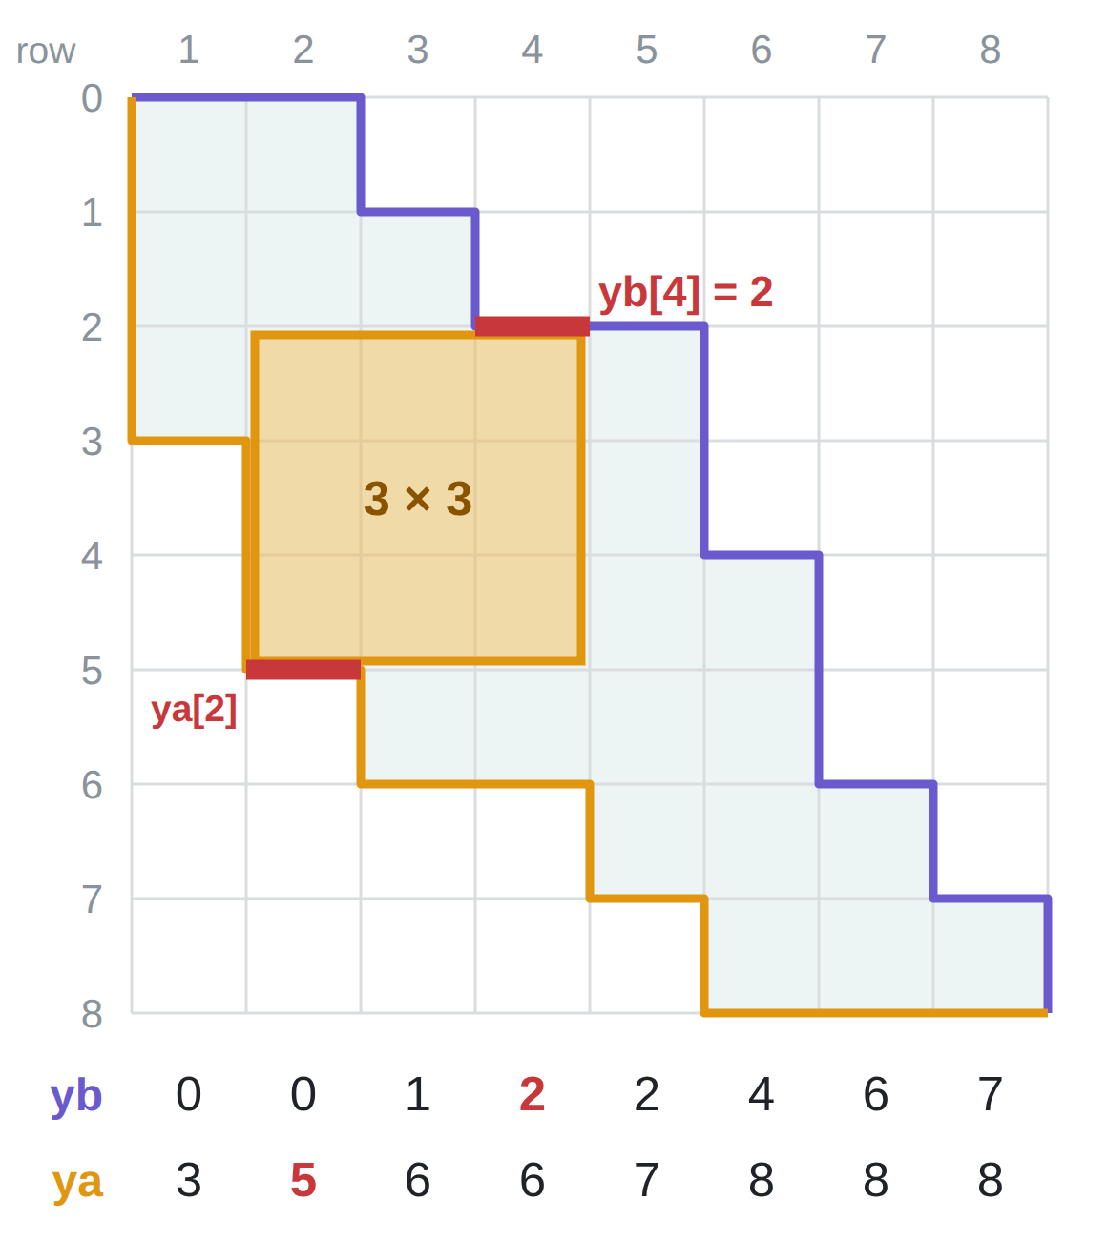
LASER CUTTER · KEY OBSERVATION 2
DOES AN S×S SQUARE FIT AT COLUMNS X … X+S−1?
Top edge: below every column's top → the strictest is the rightmost column, yb[x+s−1].
Bottom edge: above every column's bottom → the strictest is the leftmost column, ya[x].
fits ⇔ ya[x] − yb[x+s−1] ≥ s
If s fits, s−1 fits too. Solution space s = 1, 2, 3, …: ✓ ✓ ✓ ✓ ✗ ✗ → binary search for the last ✓, each check O(N).
Same board: x = 2, s = 3 → 5 − 2 = 3 ≥ 3, fits
Notes:
常见错误：在同一列里同时检查上下边界。画图说明：最右一列限制顶边，最左一列限制底边（因为 yb、ya 都单调不减）。
解空间：s = 1, 2, 3, … 时 check(s) 的形状是 ✓✓✓✓✗✗（放得下的边长越小越容易），所以找最后一个 ✓ → 输出 r。
右图沿用上一页的例子，放一个 3 × 3 的正方形在第 2–4 列（x = 2，s = 3）。顶边受三列中最低的顶部限制：yb 单调不减，所以是最右一列 yb[4] = 2；底边受最高的底部限制：ya 单调不减，所以是最左一列 ya[2] = 5（两条红线）。5 − 2 = 3 ≥ 3，放得下。
提问：这个例子里最大能放多大的正方形？答案：3。s = 4 时每个 x 都放不下：x = 1：3 − 2 = 1；x = 2：5 − 2 = 3；x = 3：6 − 4 = 2；x = 4：6 − 6 = 0；x = 5：7 − 7 = 0，都 < 4。

Slide 12
LASER CUTTER · WORK IT BY HAND
SAMPLE 2
N = 6 A = DDDDDDRRRRRR B = RDRRDDDRRRDD
x | 1 | 2 | 3 | 4 | 5 | 6
ya[x]
yb[x]
6
6
6
6
6
6
0
1
1
4
4
4
1
5
yes
s = 3: try x = ___ → ya − yb = ___ → fits? ____
s = 4: x = 1, 2, 3 → ___, ___, ___ → fits? ____ Answer = ___
2
2
2
no
3
Notes:
放映时按键（或点击）逐步显示红色答案，共 5 下：① ya 行 ② yb 行 ③ s = 3 那一行 ④ s = 4 那一行 ⑤ Answer。先让学生在纸上填，再一下一下揭晓。
答案：ya = 6 6 6 6 6 6，yb = 0 1 1 4 4 4。
s = 3，x = 1：6 − yb[3] = 6 − 1 = 5 ≥ 3，放得下。
s = 4：x = 1：6 − yb[4] = 2；x = 2：6 − yb[5] = 2；x = 3：6 − yb[6] = 2。都放不下。答案 3。

Slide 13
LASER CUTTER · CORE CODE
TRACE() AND CHECK(S)
// record the row at each R step
void trace(char p[], int y[]){
int row = 0, col = 1;
for (int i = 0; i < 2 * n; i ++){
if (p[i] == 'D')
row ++;
else{
y[col] = row;
col ++;
}
}
}
bool check(int s){
for (int x = 1; x + s - 1 <= n; x ++)
if (ya[x] - yb[x + s - 1] >= s)
return true;
return false;
}
// largest s that fits:
// "last value that passes" → r
Notes:
复杂度 O(N log N)。二分就是模板页右侧"找最后一个可行值"的写法，l = 1，r = n，输出 r。

Slide 14
LASER CUTTER · SCORING ROUTE
SUBTASKS AND COMMON MISTAKES
Subtask ladder
Common mistakes
A goes all the way down first: ya is all N, only the top matters
N ≤ 10, N ≤ 1000: brute force / 2D prefix sums
Full: binary search on s
Swapping which cut is the upper boundary
Checking top and bottom in the same column
Printing l instead of r
Notes:
挑战：能不能不用 Binary Search？
答案：设 g(x) 为从第 x 列开始能放下的最大正方形边长，可以证明 g(x+1) ≥ g(x) − 1，所以用一个只往前走的指针就能在 O(N) 内求出所有 g(x)。这就是 Two Pointers 版本。

Slide 15
LASER CUTTER · COMPLEXITY RECAP
FROM O(N³) TO O(N LOG N)
Approach | Time | Operations
Brute force: every corner, every size, 2D prefix sums | O(N³) | 8 × 10¹⁵ ✗ (the grid does not even fit)
Staircase arrays yb, ya; try every s with an O(N) check | O(N²) | 4 × 10¹⁰ ✗
+ Binary Search on s (fits is monotone) | O(N log N) | ≈ 3.6 × 10⁶ ✓
Optional: one forward-moving pointer | O(N) | 2 × 10⁵ ✓
Binary Search turns "try all N sizes" into about 18 checks, because "an s × s square fits" is monotone in s.
Notes:
复杂度回顾（N = 200 000）：
暴力：每个左上角、每个边长，用二维前缀和检查，O(N³) ≈ 8×10¹⁵，而且 N×N 的格子根本存不下。
第一步化简：用两条阶梯 yb、ya 描述形状，一次检查 O(N)；如果逐个尝试 s，是 O(N²) ≈ 4×10¹⁰，仍然太慢。
第二步：因为"放得下"关于 s 单调，二分 s，只要约 log₂(2×10⁵) ≈ 18 次检查，O(N log N) ≈ 3.6×10⁶。
选做：用一个只往前走的指针可以做到 O(N)（见作业的挑战题）。
提问：二分本身省掉了什么？答案：省掉的是"尝试多少个 s"（从 N 个变成 log N 个），每次检查的 O(N) 没有变。

Slide 16
2021 AIO PROBLEM 5
SPACE MISSION
The array is not monotone. Make one that is.
Binary Search · main
Prefix Sum · support (prefix min)
Two Pointers
Greedy
Notes:
约 20 分钟。和 Laser Cutter 对比：那里的阶梯是题目给的；这里要自己造出单调性。

Slide 17
SPACE MISSION
THE PROBLEM
Using the portal on day i costs C[i] fuel. Pick a launch day i and a return day j (i < j) with C[i] + C[j] ≤ F.
Maximise the number of days j − i + 1. Print −1 if impossible.
N ≤ 100 000, F, C[i] ≤ 10⁹
Brute force: every pair (i, j), O(N²). Subtask 1 only.
Notes:
提问：固定返回日 j，我们想要哪个出发日？
答案：最靠左的 i，满足 C[i] ≤ F − C[j]。

Slide 18
SPACE MISSION · KEY OBSERVATION
ASK A MONOTONE QUESTION INSTEAD
Fix j. We want the leftmost i with C[i] ≤ need = F − C[j]. C itself has no order, so we cannot binary search it.
But "some day among the first t costs ≤ need" can only switch from no to yes as t grows. It is the same as:
pm[t] ≤ need, where pm[t] = min(C[1..t])
pm never increases, so t = 1 … j−1 gives ✗ ✗ ✓ ✓ ✓ → binary search for the first ✓.
Notes:
前缀最小值（prefix minimum）是 prefix sum 的"min 版本"：两者都是把前 i 个数合起来。这时可以强调"单调性是我们自己造出来的"。
解空间：t = 1 … j−1 时"pm[t] ≤ need"的形状是 ✗✗✓✓✓（pm 只会变小），所以找第一个 ✓ → 输出 l。

Slide 19
SPACE MISSION · WORK IT BY HAND
SAMPLE 2: F = 14
day i | 1 | 2 | 3 | 4 | 5 | 6 | 7
C[i] | 12 | 8 | 2 | 16 | 4 | 6 | 10
pm[i]
12
8
2
2
2
2
2
8
2
5
j = 6: need = ___ → first i = ___ → days = ___
j = 7: need = ___ → first i = ___ → days = ___
j = 4: need = ____ → _____ Answer = ___
4
3
5
−2
none
5
Notes:
放映时按键（或点击）逐步显示红色答案，共 5 下：① pm 行 ② j = 6 那一行 ③ j = 7 那一行 ④ j = 4 那一行 ⑤ Answer。先让学生在纸上填，再一下一下揭晓。
答案：pm = 12 8 2 2 2 2 2。
j = 6：need = 8 → 第一个 pm ≤ 8 的是 i = 2 → 5 天。
j = 7：need = 4 → i = 3 → 5 天。
j = 4：need = −2 → 找不到。
答案 5。

Slide 20
SPACE MISSION · CORE CODE
PREFIX MINIMUM, THEN ONE SEARCH PER J
pm[1] = c[1];
for (int i = 2; i <= n; i ++)
pm[i] = min(pm[i-1], c[i]);
for (int j = 2; j <= n; j ++){
long long need = F - c[j];
int l = 1, r = j - 1; // first i with pm[i] <= need → l
while (l <= r){
int mid = (l + r) / 2;
if (pm[mid] <= need) r = mid - 1;
else l = mid + 1;
}
if (l <= j - 1) ans = max(ans, j - l + 1);
}
Notes:
ans 初始化为 −1。复杂度 O(N log N)。这是后面的现场编码题，先不要发代码。

Slide 21
COMPARE THE PAIR
TWO WAYS TO USE BINARY SEARCH
 | Space Mission (P5) | Laser Cutter (P6)
Search over | An index in the array pm | The answer (square side)
Monotone because | We built it (prefix min) | The problem gave it (staircase)
How many searches | One per j: N searches | One search, O(N) check each step
Notes:
挑战：Space Mission 能不能用 Two Pointers 做到 O(N)？
答案：最优的出发日 i 一定是"前缀最小值创新低"的那一天，最优的返回日 j 一定是"后缀最小值"的那一天。把这两组位置分别列出来：i 往右走时 C[i] 变小，允许的 C[j] 上限 F − C[i] 变大，能用的最远 j 只会往右移，所以一个指针扫一遍即可，O(N)。

Slide 22
SPACE MISSION · COMPLEXITY RECAP
FROM O(N²) TO O(N LOG N)
Approach | Time | Operations
Brute force: every pair (i, j) | O(N²) | 10¹⁰ ✗
Prefix minimum pm + Binary Search for each j | O(N log N) | ≈ 1.7 × 10⁶ ✓
Optional: Two Pointers on pm | O(N) | 10⁵ ✓
C has no order, so we built one: pm never increases. Then each j needs about 17 checks instead of j.
Notes:
复杂度回顾（N = 100 000）：
暴力：枚举每一对 (i, j)，O(N²) = 10¹⁰。
关键：C 本身没有顺序，不能二分；先花 O(N) 造出前缀最小值 pm，它只会变小（单调），于是对每个 j 二分找第一个 pm[t] ≤ F − C[j]，每个 j 只要约 log₂(10⁵) ≈ 17 次比较，总共 O(N log N) ≈ 1.7×10⁶。
选做：j 增大时答案的位置也有单调性，可以用双指针做到 O(N)。
提问：如果直接在 C 上二分会怎样？答案：C 不单调，二分会跳过正确答案，结果错误。

Slide 23
2019 AIO PROBLEM 6
LOLLIPOPS, SWEETS AND CHOCOLATES II
The condition is not monotone. Its sum is.
Binary Search · main
Two Pointers · support
Prefix Sum
Greedy
Notes:
约 30 分钟。今天最难的"自己造单调性"。

Slide 24
LOLLIPOPS II
THE PROBLEM
N shops and M houses on a line. For a radius R, each house counts the shops within distance R.
You are given the M counts in sorted order, not matched to houses. Find any R (0 ≤ R ≤ L) that produces exactly these counts, or −1.
N, M ≤ 100 000, L ≤ 10⁹
So we compare multisets: sort our counts and compare with s.
Notes:
在数轴上画样例 1：商店 1 5 8 9，房子 3 6 8 10 14。

Slide 25
LOLLIPOPS II · QUESTION 1
TOO MANY VALUES OF R
Try every R from 0 to L: count, sort, compare. O(L · M log M), and L is 10⁹.
Can we binary search R? Only if something is monotone in R.
R = 0, 1, 2, …: ✗ ✗ ✗ ✓ ✓ ✗ ✗ ✗ A ✗ at mid could be left or right of the ✓ block.
"Sorted counts equal s" is not monotone. You cannot binary search it directly.
Notes:
Subtask 2–4：只有商店和房子之间的距离会改变某个计数，所以只有约 N·M 个"有意义的"R，逐个检查就能拿这些 subtask。
解空间："排序后的计数等于 s"随 R 变化的形状是 ✗✗✗✓✓✗✗✗：✓ 是中间的一段（因为每个计数随 R 单调不减，所以 ✓ 一定连成一段）。查到一个 ✗ 时，不知道 ✓ 段在它左边还是右边，所以不能二分。

Slide 26
LOLLIPOPS II · KEY OBSERVATIONS
FIND THE MONOTONE QUANTITY
1. Each house's count never decreases as R grows.
2. So the sorted vector v(R) never decreases in any position.
3. Let S = sum of s. If two radii both give sum S, every position must be equal: all radii with sum S give the same vector.
Hint for 3: take R₁ < R₂ with the same sum S. By 2, every difference v(R₂)[k] − v(R₁)[k] is ≥ 0. The differences add up to S − S = 0. What must each one be?
sum(v(R)) ≥ S? ✗ ✗ ✗ ✓ ✓ ✓ ✓ → binary search the first ✓, then compare once.
Notes:
观察 2 是一个很好的小证明：如果每个数都不变小，那么排序后第 k 小的数也不会变小。
观察 3 的证明（页面上的提示）：取 R₁ < R₂，总和都是 S。由观察 2，每个位置的差 v(R₂)[k] − v(R₁)[k] ≥ 0；这些差加起来等于 S − S = 0。几个非负数的和是 0，只能每个都是 0，所以两个向量完全相同。
提问：如果 R₁ < R₂ 且 sum(v(R₂)) > sum(v(R₁))，能说明什么？答案：至少有一个位置严格变大，两个向量一定不同。
解空间："sum(v(R)) ≥ S"随 R 的形状是 ✗✗✗✓✓✓✓，单调 → 二分找第一个 ✓。然后只检查这一个 R。

Slide 27
LOLLIPOPS II · WHY ONE CHECK IS ENOUGH
IF THAT R FAILS, EVERY R FAILS
Sum at the smallest R is already > S: bigger R give sums > S, smaller R give sums < S. No R reaches exactly S.
Sum is S but the vector differs: by observation 3 every R with sum S has this same vector. All fail.
Also check first: if even R = L gives a sum below S, print −1.
Notes:
这就是"先用总和过滤"的想法。样例 2 很好地说明了这一点：总和从 3 直接跳到 5，永远等不到 4。

Slide 28
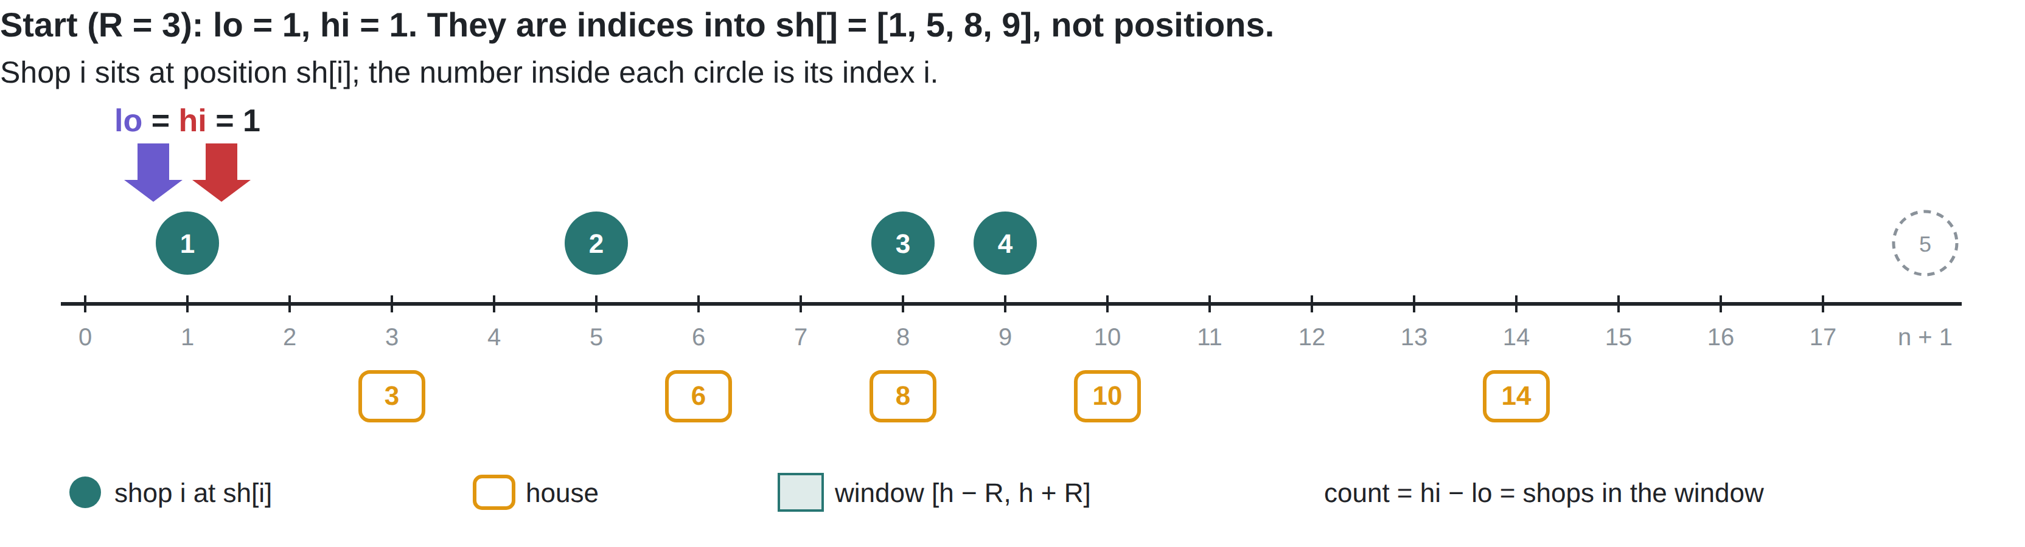
LOLLIPOPS II · COUNTING FAST
TWO POINTERS FOR EVERY COUNT
Houses go left to right, so the window [h − R, h + R] slides right. Both pointers only move forward: at most N steps in total → O(N + M) per R.
hi = first index with sh[hi] > h + R
lo = first index with sh[lo] ≥ h − R
count = hi − lo
Notes:
下方的图是样例 1、R = 3 的完整过程，从这一页开始连续 6 页（起点 + 每栋房子一页），每翻一页处理一栋房子。
注意：lo 和 hi 是商店数组 sh[] 的下标（1 开始），不是位置。图中圆圈里的数字就是下标 i，圆圈画在位置 sh[i] 上；箭头指向"下标为 lo / hi 的那家商店"。n + 1 = 5 表示已经越过最后一家商店。
实线箭头是指针的新值，虚线是上一步的值。让学生先预测指针会不会动、动几步，再翻页。
关键点：两个指针都只往右走，五栋房子一共只走了 lo 4 步、hi 4 步（都到了 n + 1），而不是每栋房子重新数一遍。
参考（样例 1，R = 3，sh = [1, 5, 8, 9]）：计数依次为 2、3、3、2、0，总和 10。

Slide 29
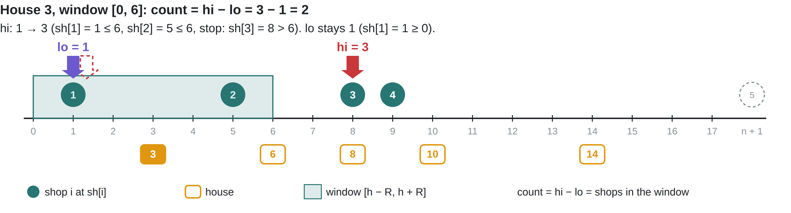
LOLLIPOPS II · COUNTING FAST
TWO POINTERS FOR EVERY COUNT
Houses go left to right, so the window [h − R, h + R] slides right. Both pointers only move forward: at most N steps in total → O(N + M) per R.
hi = first index with sh[hi] > h + R
lo = first index with sh[lo] ≥ h − R
count = hi − lo
Notes:
两指针演示第 1 / 5 步。房子 3 → 窗口 [0, 6]：hi 从 1 走到 3（sh[1] = 1、sh[2] = 5 都 ≤ 6，sh[3] = 8 > 6 停下）；lo 仍为 1。计数 = 3 − 1 = 2。
翻页前先问学生：下一步 lo 和 hi 会动吗？动几格？

Slide 30
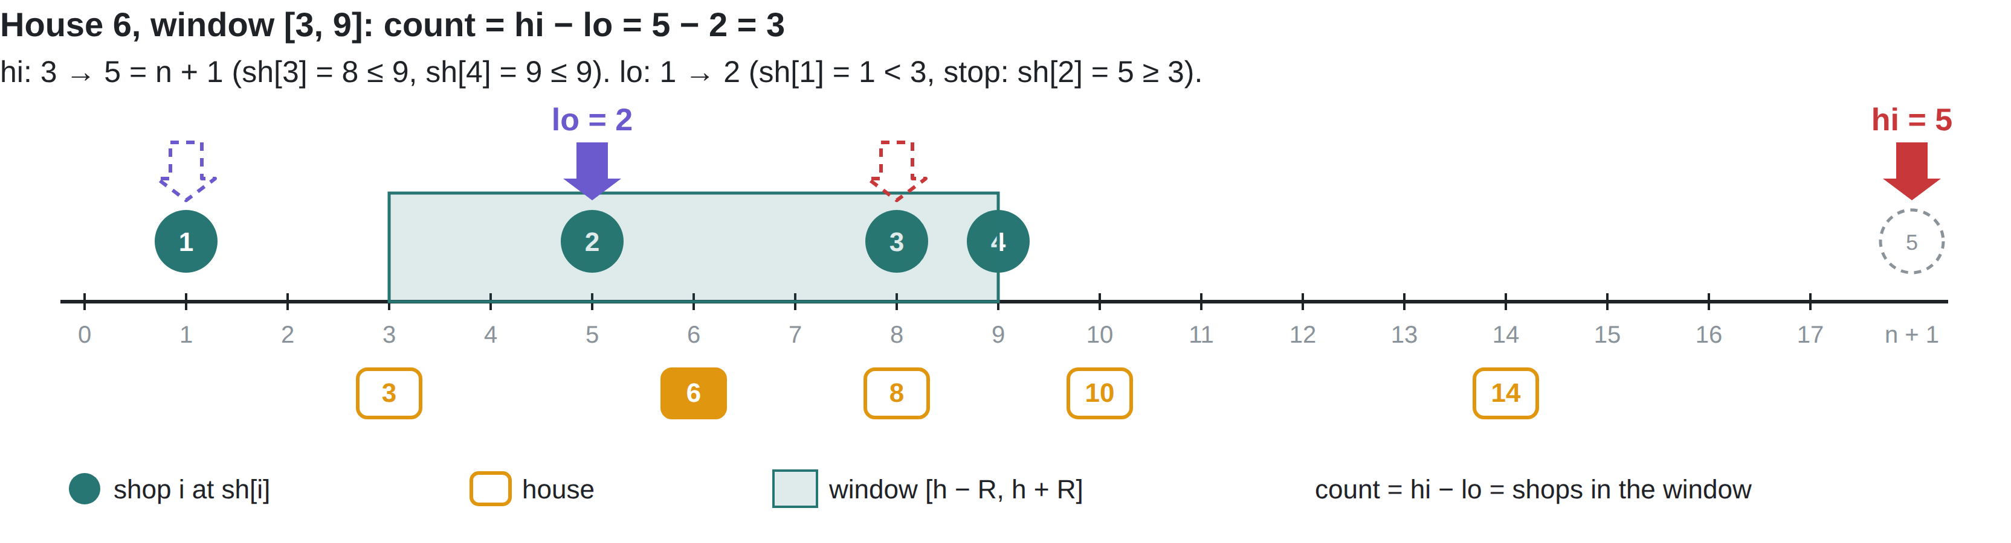
LOLLIPOPS II · COUNTING FAST
TWO POINTERS FOR EVERY COUNT
Houses go left to right, so the window [h − R, h + R] slides right. Both pointers only move forward: at most N steps in total → O(N + M) per R.
hi = first index with sh[hi] > h + R
lo = first index with sh[lo] ≥ h − R
count = hi − lo
Notes:
两指针演示第 2 / 5 步。房子 6 → 窗口 [3, 9]：hi 从 3 走到 5 = n + 1（sh[3] = 8、sh[4] = 9 都 ≤ 9）；lo 从 1 走到 2（sh[1] = 1 < 3，sh[2] = 5 ≥ 3 停下）。计数 = 5 − 2 = 3。
翻页前先问学生：下一步 lo 和 hi 会动吗？动几格？

Slide 31
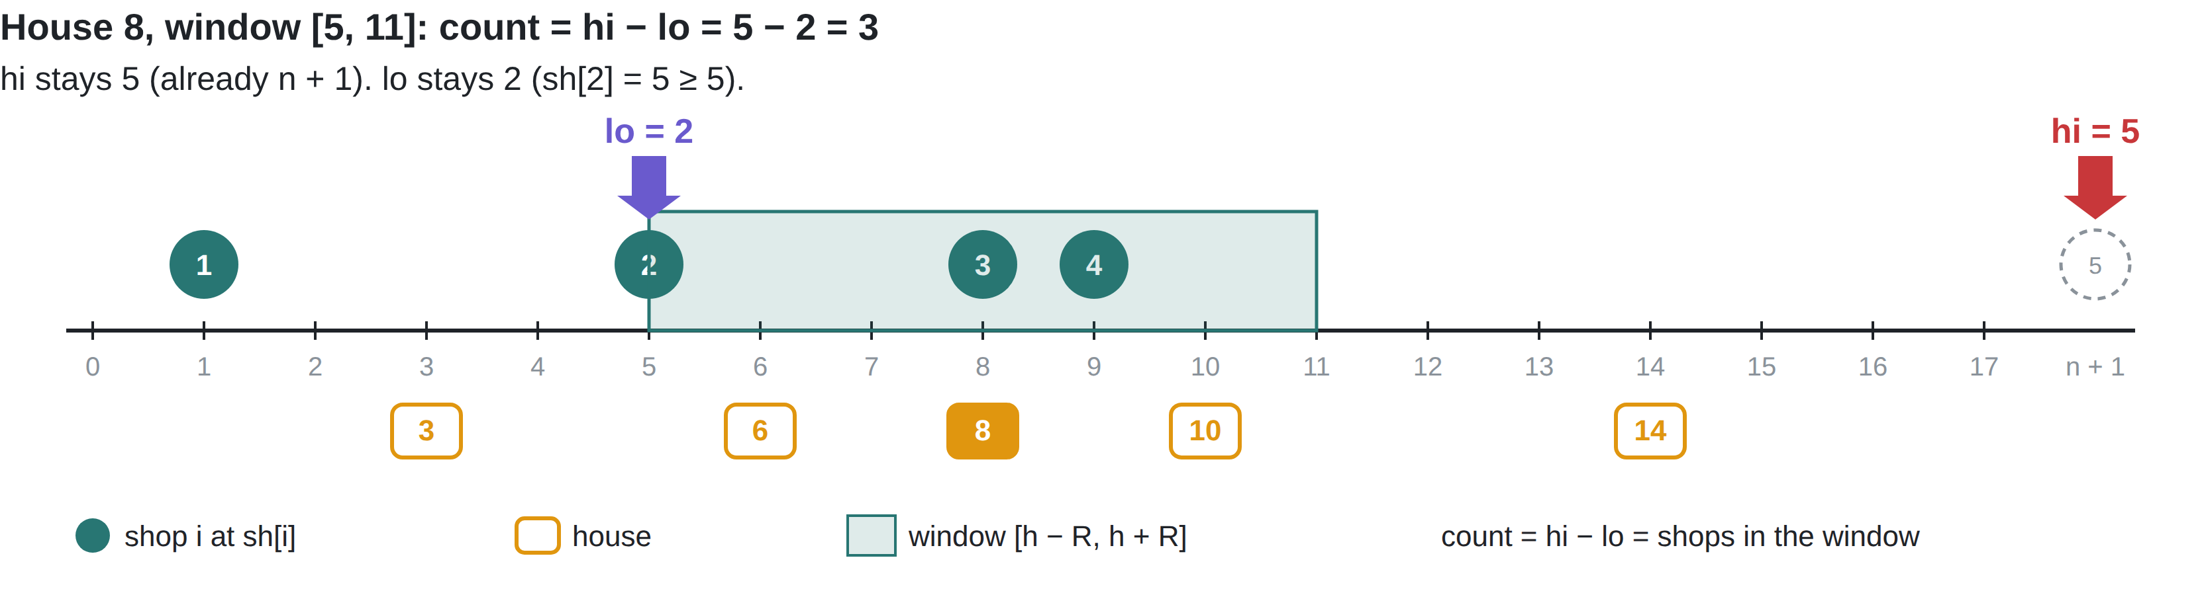
LOLLIPOPS II · COUNTING FAST
TWO POINTERS FOR EVERY COUNT
Houses go left to right, so the window [h − R, h + R] slides right. Both pointers only move forward: at most N steps in total → O(N + M) per R.
hi = first index with sh[hi] > h + R
lo = first index with sh[lo] ≥ h − R
count = hi − lo
Notes:
两指针演示第 3 / 5 步。房子 8 → 窗口 [5, 11]：hi 已是 n + 1；lo 仍为 2（sh[2] = 5 ≥ 5）。计数 = 5 − 2 = 3。
翻页前先问学生：下一步 lo 和 hi 会动吗？动几格？

Slide 32
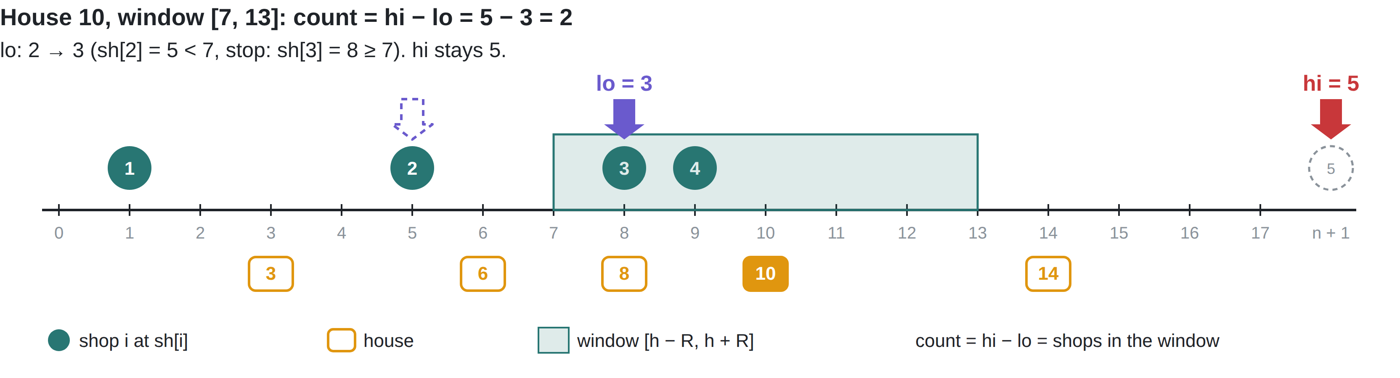
LOLLIPOPS II · COUNTING FAST
TWO POINTERS FOR EVERY COUNT
Houses go left to right, so the window [h − R, h + R] slides right. Both pointers only move forward: at most N steps in total → O(N + M) per R.
hi = first index with sh[hi] > h + R
lo = first index with sh[lo] ≥ h − R
count = hi − lo
Notes:
两指针演示第 4 / 5 步。房子 10 → 窗口 [7, 13]：lo 从 2 走到 3（sh[2] = 5 < 7，sh[3] = 8 ≥ 7 停下）；hi 不动。计数 = 5 − 3 = 2。
翻页前先问学生：下一步 lo 和 hi 会动吗？动几格？

Slide 33
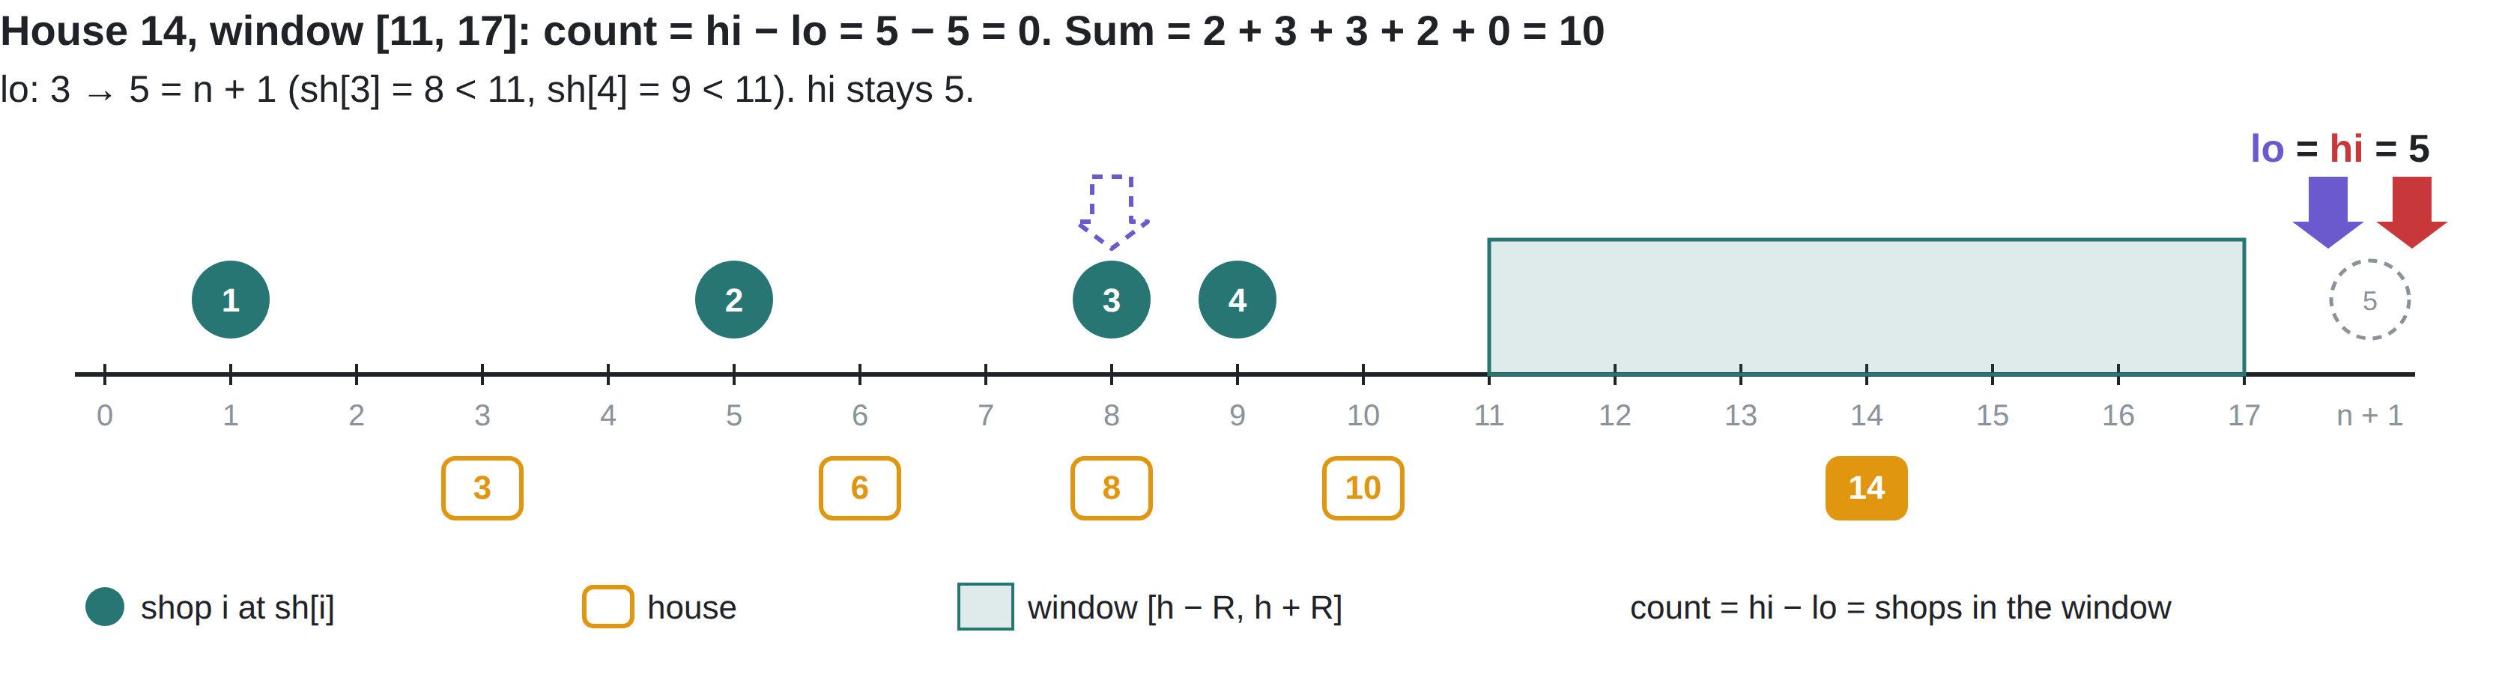
LOLLIPOPS II · COUNTING FAST
TWO POINTERS FOR EVERY COUNT
Houses go left to right, so the window [h − R, h + R] slides right. Both pointers only move forward: at most N steps in total → O(N + M) per R.
hi = first index with sh[hi] > h + R
lo = first index with sh[lo] ≥ h − R
count = hi − lo
Notes:
两指针演示第 5 / 5 步。房子 14 → 窗口 [11, 17]：lo 从 3 走到 5 = n + 1（sh[3] = 8、sh[4] = 9 都 < 11）；hi 不动。计数 = 5 − 5 = 0。五栋房子的总和 10。
总结：两个指针都只往右走，全程 lo 4 步、hi 4 步。

Slide 34
LOLLIPOPS II · WORK IT BY HAND
SAMPLE 1: S = 10
Shops 1 5 8 9 Houses 3 6 8 10 14 s = 0 2 2 3 3
R | house 3 | house 6 | house 8 | house 10 | house 14 | sum
2
3
2
2
2
2
0
8
2
3
3
2
0
10
3
yes
3
Smallest R with sum ≥ 10: ___ Sorted counts = s? ____ Answer: ___
Notes:
放映时按键（或点击）逐步显示红色答案，共 5 下：① R = 2 行 ② R = 3 行 ③ 最小的 R ④ 排序后是否等于 s ⑤ Answer。先让学生在纸上填，再一下一下揭晓。
答案：R = 2：2 2 2 2 0，总和 8。R = 3：2 3 3 2 0，总和 10。最小的 R 是 3；排序后 0 2 2 3 3 = s；答案 3（R = 4 得到同样的向量，也被接受，正好印证观察 3）。
样例 2：商店 1 3 5，房子 2 6，s = 1 3（S = 4）。R = 2 总和 3，R = 3 总和 5：总和永远不等于 4，输出 −1。

Slide 35
LOLLIPOPS II · CORE CODE
TOTAL(R) AND THE SEARCH
long long total(long long R){
int lo = 1, hi = 1;
long long sum = 0;
for (int i = 1; i <= m; i ++){
while (hi <= n && sh[hi] <= ho[i] + R)
hi ++;
while (lo <= n && sh[lo] < ho[i] - R)
lo ++;
cnt[i] = hi - lo;
sum += cnt[i];
}
return sum;
}
// first R with sum >= S → l
long long l = 0, r = L;
while (l <= r){
long long mid = (l + r) / 2;
if (total(mid) >= S)
r = mid - 1;
else
l = mid + 1;
}
total(l);
sort(cnt + 1, cnt + m + 1);
// compare cnt with s
Notes:
注意边界：<= ho[i] + R，但 < ho[i] − R，一个等号写错就会出错。总和用 long long（最大 M × N = 10^10）。

Slide 36
LOLLIPOPS II · COMPLEXITY RECAP
TWO TECHNIQUES, TWO SPEED-UPS
Approach | Time | Operations
Try every R, count each house by scanning all shops | O(L · N · M) | 10¹⁹ ✗
Try every R, Two Pointers count | O(L · (N + M)) | 2 × 10¹⁴ ✗
Binary Search on R (the sum is monotone) + Two Pointers count | O((N + M) log L) | ≈ 6 × 10⁶ ✓
Then sort the counts once and compare | O(M log M) | ≈ 1.7 × 10⁶ ✓
Binary Search cuts 10⁹ radii to about 30. Two Pointers cuts each count from N · M to N + M.
Notes:
复杂度回顾（N, M ≤ 10⁵，L ≤ 10⁹）：
最朴素：枚举每个 R，再对每栋房子扫一遍所有商店，O(L·N·M) ≈ 10¹⁹。
只用 Two Pointers：每个 R 的计数降到 O(N + M)，但 R 有 10⁹ 个，仍是 2×10¹⁴。
再加 Binary Search：真正单调的是计数总和，二分 R 只要约 log₂(10⁹) ≈ 30 次，每次 O(N + M)，共 ≈ 6×10⁶；最后对找到的 R 排序比较一次，O(M log M)。
提问：两个技巧各自省掉了什么？答案：Binary Search 省掉"尝试多少个 R"（10⁹ → 30），Two Pointers 省掉"每次计数的代价"（N·M → N + M）。

Slide 37
TODAY'S BIG IDEA
WHERE DOES THE MONOTONICITY COME FROM?
Problem | Not monotone | Monotone instead | Solution space
Laser Cutter | — | Staircase cuts: given by the problem | s: ✓ ✓ ✓ ✗ ✗ last ✓
Space Mission | The cost array C | Prefix minimum pm: we built it | t: ✗ ✗ ✓ ✓ ✓ first ✓
Lollipops II | "Sorted counts equal s" | Sum of counts: we built it | R: ✗ ✗ ✓ ✓ ✓ first ✓
No monotone quantity? Look for one you can build: a prefix min, a sum, a count.
Notes:
先让学生填右边一列，再显示答案。
参考答案：Laser Cutter：本身就是单调的阶梯，题目给的；Space Mission：花费数组 C 不单调 → 前缀最小值 pm 单调，我们造的；Lollipops II："排序后的计数等于 s"不单调 → 计数总和单调，我们造的。
最后一列：三道题的解空间形状。Laser Cutter 找最后一个 ✓（输出 r），另外两道找第一个 ✓（输出 l）。

Slide 38
LIVE CODING · 25 MINUTES
WRITE SPACE MISSION FROM SCRATCH
Read N, F and C[1..N] (long long)
Build pm[i] = min(pm[i-1], C[i])
For each j: binary search the first i in [1, j−1] with pm[i] ≤ F − C[j]
Keep the best j − i + 1; start ans at −1
Test the samples: expect 4, 5, −1
Finished early? Write total(R) for Lollipops II and check sample 1 gives sums 8 and 10 for R = 2, 3.
Submit: orac2.info/problem/1101
Notes:
常见 bug：在 pm[1..j] 上搜索，而不是 pm[1..j−1]（出发日和返回日必须不同）；忘了输出 −1；F − C[j] 用 int 不会溢出，但为了保险还是用 long long。
样例答案：样例 1 = 4，样例 2 = 5，样例 3 = −1。

Slide 39
RECAP
TECHNIQUES USED SO FAR
Problem | Prefix Sum | Binary Search | Two Pointers | Greedy
Spaceship Shuffle | main |  |  | median
Tennis Robot II | main
Twin Rivers | main | bridges
Laser Cutter |  | main | optional
Space Mission | prefix min | main
Lollipops II |  | main | counting
Notes:
这张表每次课都会变长。Greedy 那一列现在还几乎是空的：那是第 3 次课的内容。

Slide 40
BEFORE LESSON 3
HOMEWORK
Laser Cutter: full program · orac2.info/problem/1100
Lollipops II: full program · orac2.info/problem/147
Challenge: Laser Cutter without binary search, using one forward-moving pointer (O(N))
Notes:
下次课：Greedy 和水位线（water level）。提醒学生把 binary search 模板留在手边，下次每道题都会用到。

